Slide 1
Twitter Sentiment Analysis
-Siddharth Verma
Sec- J
Rono- 48

Slide 2
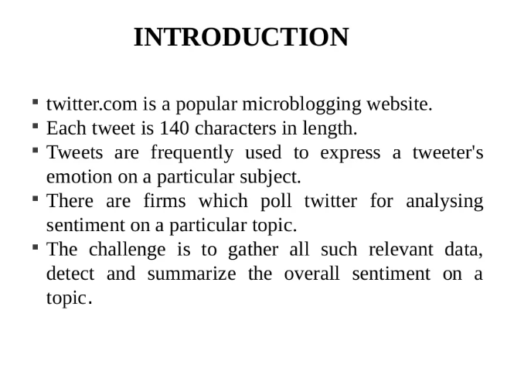

Slide 3
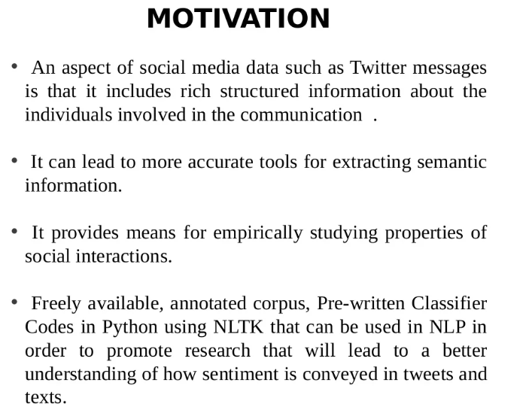

Slide 4
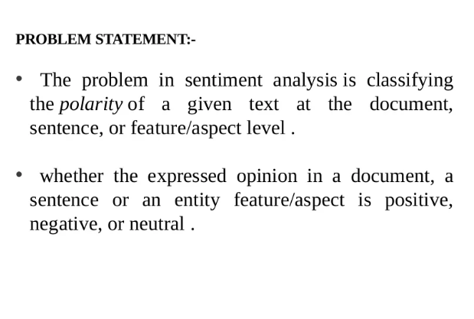

Slide 5
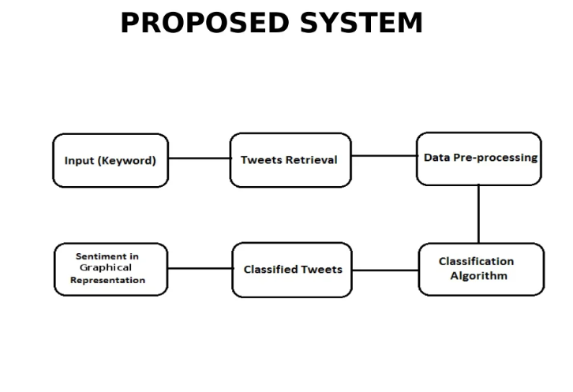

Slide 6
Tweepy:-
Tweepy is an open source Python package that gives you a very convenient way to access the Twitter API with Python.
Tweepy includes a set of classes and methods that represent Twitter’s models and API endpoints, and it transparently handles various implementation details, such as:
Data encoding and decoding
HTTP requests
Results pagination
OAuth authentication

Slide 7
TEXTBLOB:-
TextBlob is a Python library for processing textual data.
It provides a simple API for diving into common natural language processing (NLP) tasks such as part-of-speech tagging, noun phrase extraction, sentiment analysis, classification, translation, and more.
When computing a sentiment for a single word, TextBlob employs the “averaging” technique, which is applied to polarity values to calculate a polarity score for a single word,

Slide 8
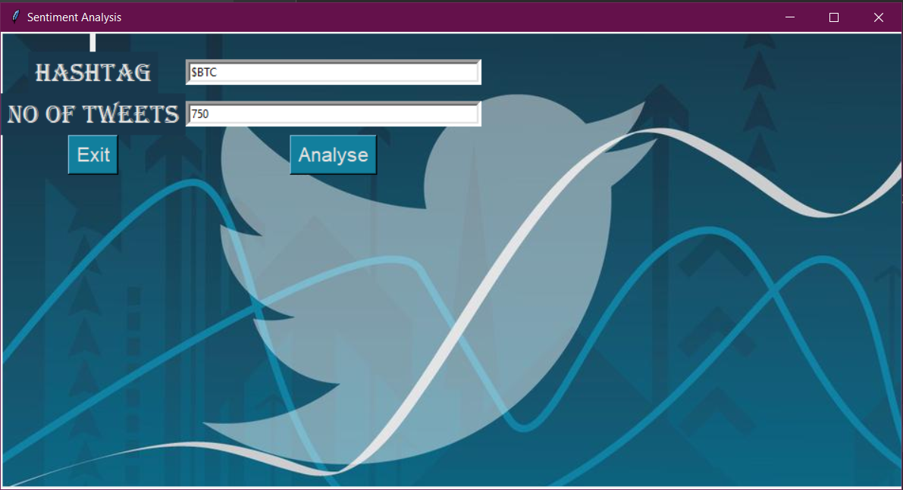
Analysis of Bitcoin using 750 tweets

Slide 9
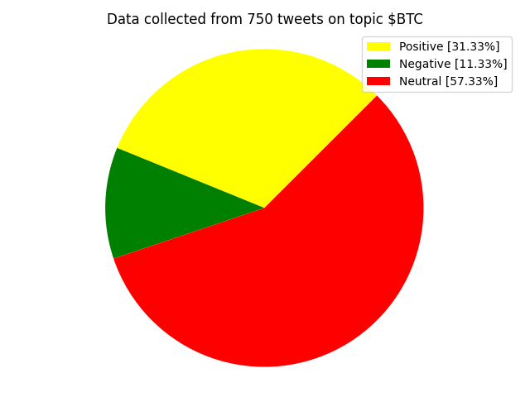

Slide 10
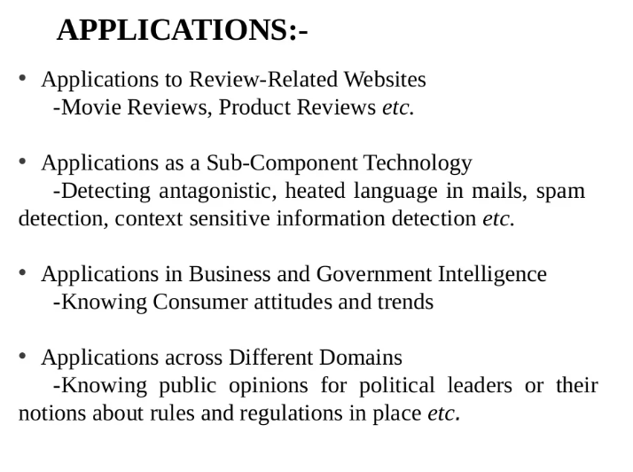

Slide 11
Conclusion:-
By getting through different classifiers we can improve the performance of model and increase the accuracy.
Future Work:-
Free twitter developer account allows only 2 million tweet extraction and 900 tweets/15min so the result may get affected by bias so paid version can be used to better analysis of particular asset.

Slide 12
Thank you

